Slide 1

MEETING 3 JOB INTERVIEW
GRAMMAR
Simple Past Tense
Past Continuous Tense
Past Perfect Tense
Past Perfect Continuous Tense.

Slide 2


WRITING APPLICATION LETTER & CV (CURRICULUM VITAE)
UNIVERSITAS DIAN NUSWANTORO
SEMARANG
Liya.umaroh@dsn.dinus.ac.id

Slide 3

Curriculum Vitae (CV) a detailed account of someone's work experience, professional training, and educational background, as prepared by a person applying Job
Application letter Carries sequence of information regarding the qualification and experience and it also usually uses to find job

Slide 4

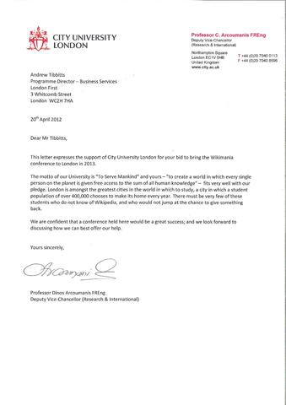
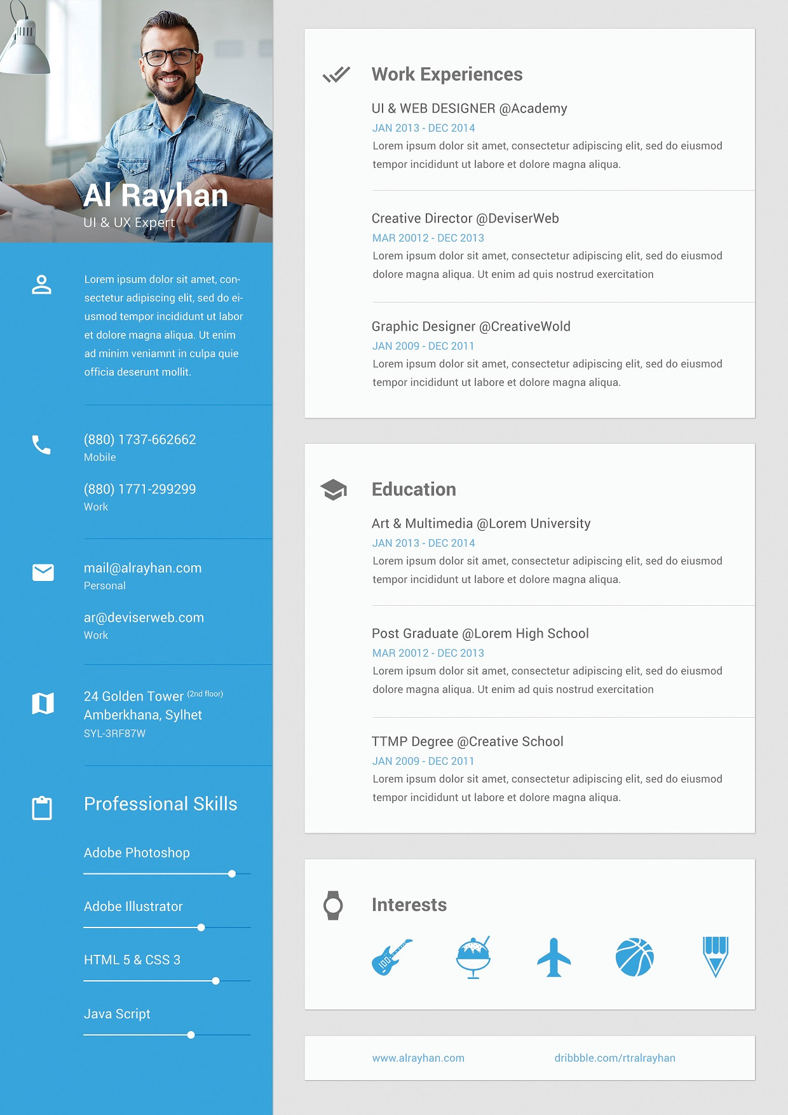
Example of CV
Example of application letter

Slide 5

Basic elements of Aplication Letter
Date of Letter
Your Address
Company address
Salutation
Letter content
Complimentary close
Signature
5

Slide 6

How to start writing your application letter?
1. Date of letter : October 30, 2020
2. Your address :
Jessica Miranda
Jl. Cendana no 33 Semarang 50141
Jessica@gmail.com
6

Slide 7
3. Company address:
BCA's Board of Commissioners and Directors
Jl MH Thamrin No.1. Grand Indonesia Menara BCA Floor 25 Jakarta 10310
recruitment@bca.co.id
4. Salutation, mention their name if you know the name
Dear Mr. Mark/ Dear Mr./Dear Mrs. Marry/Dear Ms/Dear Mrs
7

Slide 8

5. Letter Content
Opening paragraph
middle paragraph
last paragraph
State why you are writing your application letter
Job position
Mention how do you heard or see the recruitment
Explain why you are interested in working the employer
Specify your reasons for describing such type of work
Emphasize skills or abilities
Why you are the best candidate
Indicate your desire for a personal interview
You may suggest alternative date/time or advise of your flexibility time, and would like to set up an interview or say you are willing to accomodate the company’s schedule and request.
8

Slide 9

Example letter content
Opening : I am writing to apply for the programmer position advertised in Official website BCA. As requested, I enclose a completed job application, my certification, my CV, and three references
9

Slide 10
Middle paragraph:
The role is very appealing to me, and I believe that my strong technical experience and education make me a highly competitive candidate for this position. My key strengths that would support my success in this position. I have successfully designed, developed, and supported live-use applications. I strive continually for excellence. I provide exceptional contributions to customer service for all customers. With a BS degree in Computer Programming, I have a comprehensive understanding of the full lifecycle for software development projects. I also have experience in learning and applying new technologies as appropriate.
10

Slide 11
Closing: Herewith I enclose my curriculum vitae with all the important credentials required. I look forward to a positive response after the examination
6. Complimentary close : Your faithfully, your sincerely,
7. Signature
11

Slide 12
Basic elements of Curriculum vitae
Contact information and identity.
A quick summary of your skills.
Your various titles, skills, and important related information
Your degrees, certifications, additional trainings and skills you've acquired.
Your meaningful experiences and involvement in the community, related to the position you are applying for.
12

Slide 13
13

Slide 15
Simple Past Tense
The simple past is a verb tense that is used to talk about things that happened or existed before now.
Example: - Patricia entered an E-Sport games.
- She finished her homework at nine o’clock.
- My best friend died last year.
Forming the simple past tense
1. Affirmative : Subject + Verb 2
I watched Star Wars last night

Slide 16
2. Negative : Subject + did + not + bare infinitive
I did not watch Star Wars last night.
3. Interrogative (question) : Did + Subject + bare infinitive?
Did you watch Star Wars last night?
Regular Verb

Slide 17
Irregular verbs

Slide 18
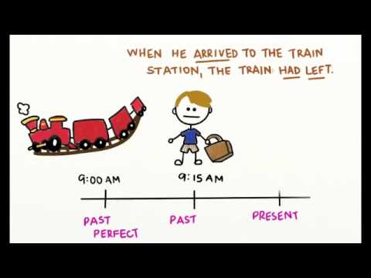
Past Perfect Tense
The past perfect tense in a sentence or conversation describes an event that happened in the past before another event in the simple past tense was completed in the past.
It does not matter which event is mentioned first - the tense makes it clear which one happened first.
The situations where a past perfect tense is used are to:
Indicate an event that has occurred and been completed in the past.
Example: Johan had borrowed money from the bank to buy his new car.
Describe an event or action which happened before a definite time in the past.
Example: We had cleaned up the terrace before the watchman arrived.
Describe an action that happened in the past before another action took place.
Example: We had reached their house after the dinner was over.
Describe a state.
Example: Their wives had become good friends at the wedding.

Slide 19
Simple past past continuous past perfect

Slide 20
REGULAR AND IRREGULAR VERB
REGULAR VERB | IRREGULAR VERB
V1= study v2= studied v3=studied V1= work v2=worked v3=worked | V1=learn v2= learnt v3 =learnt V1= Let v2= let v3=let

Slide 21
SIMPLE PAST TENSE | PAST CONTINUOUS TENSE | PAST PERFECT TENSE
S+V2 | S+WAS/WERE+VING | HAD+V3
Describe past event/activity | describe an activity in progress that gives the background to the main events | show that one events happened before another
Time expression: ago, last, yesterday, in 1990, on Saturday, the day before yesterday, last.... | Time expression: while,as, at that time,at the moment | Time expression: already, never, just, before, until
Example: Sinta joined the competition a year ago | Example: He was complaining in his class | Example: I had already joined the class when the lecturer announced on WhatsApp group

Slide 22
We use simple past to describe the main events of the story
We use past continuous to describe an activity in progress that gives the background to the main events
We use the past perfect to show that one events happened before another

Slide 23
Past perfect and simple past
Example:
A: I had my first interview at university
B: You had just passed your exams?
A: No, try again
B: You had never been so nervous as when?

